Slide 1
Problem Solving with ADT
– Stacks

Slide 2
Semester 2 Outline
Lectures: 2hrs/week 26 hours
Tutorials/Labs 26 hours
  2 hours/week
Self Study: 48 hours
References:
  Lecture Notes – attend all lectures.
  Books, “Data structures and Program Design in C”, Robert Kruse, C.L. Tondo, B Leung.
  See my Web page for References.

Slide 3
Semester 2 Outline
References. Links from my web page at www.comp.dit.ie/smulligan to:
  Java Applets for Data structures and Algorithms.
  YouTube videos on Data Structures & Algorithms.
Material: Dynamic data structures, Sorting, Searching.

Slide 4
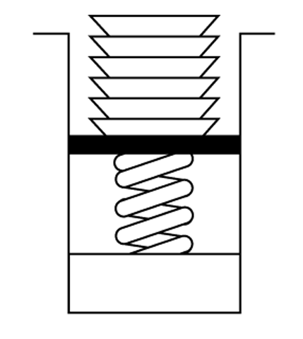
Definition of Stack
ADT level Abstract Data Type
  A stack is an ordered group of homogeneous items, in which the removal and addition of stack items can take place only at the top of the stack
  A limited access data structure
A stack is a LIFO: last item in, first out structure

Slide 5
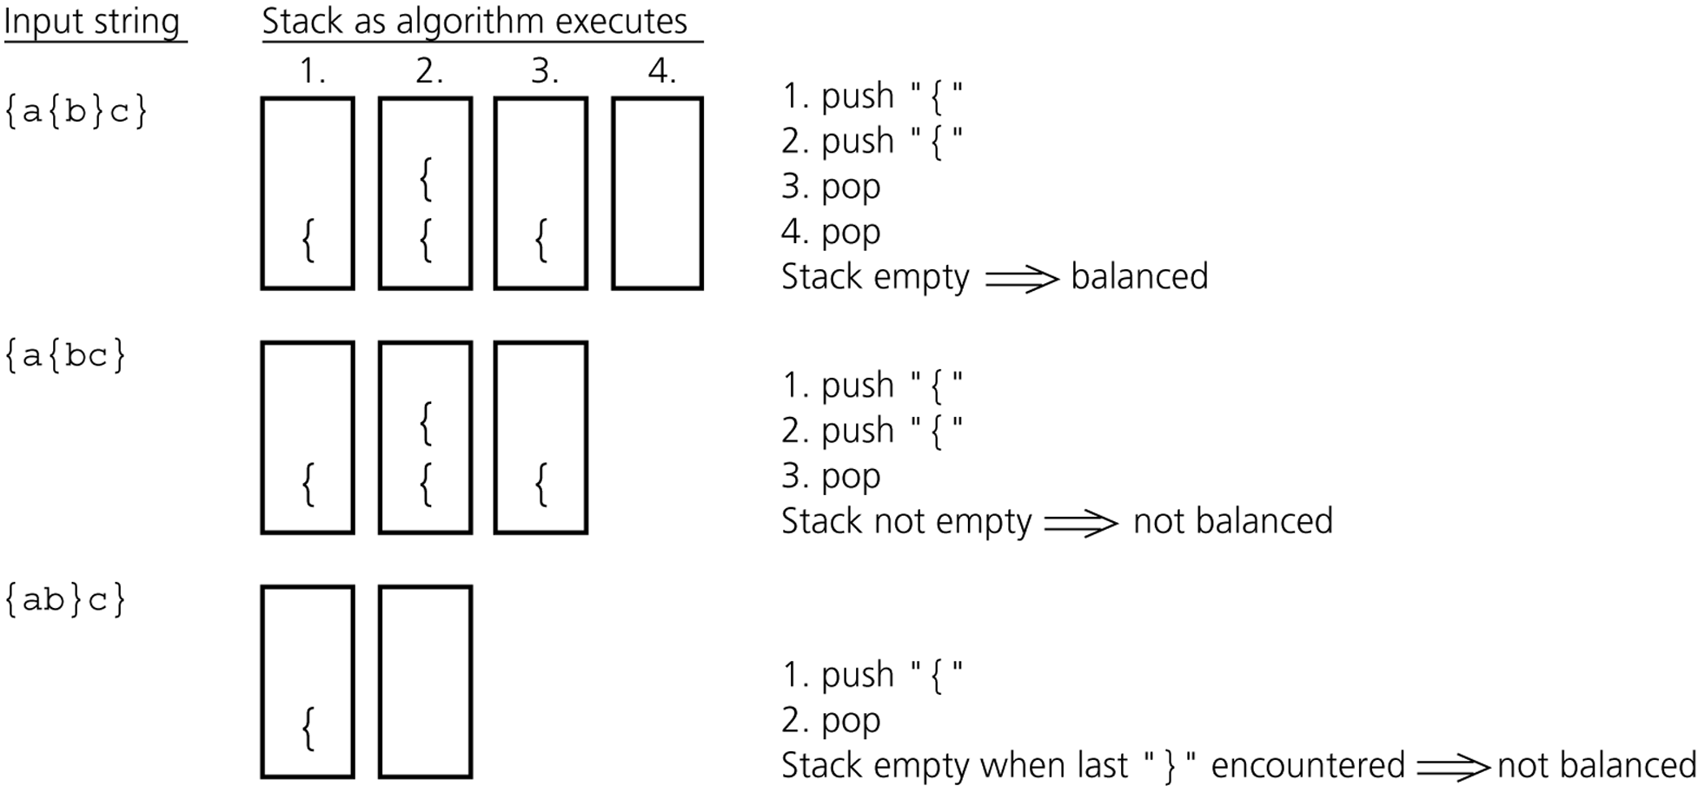
Checking for Balanced Braces
Balanced: a+{c*{a+b}*d}+{d+e}
Unbalanced: {asdf{df}{dfa{df}

Slide 6
Pseudocode
while (not end of string){
read(ch) //read character
if (ch is ‘{‘)
add ch to ADT
else if (ch is ‘}’){
if (ADT is empty)
return unbalanced;
pop from ADT the last
item added (pushed)
}
}
if (ADT is empty)
return balanced;
return unbalanced;
Add new item
Remove item
Check emptiness

Slide 7
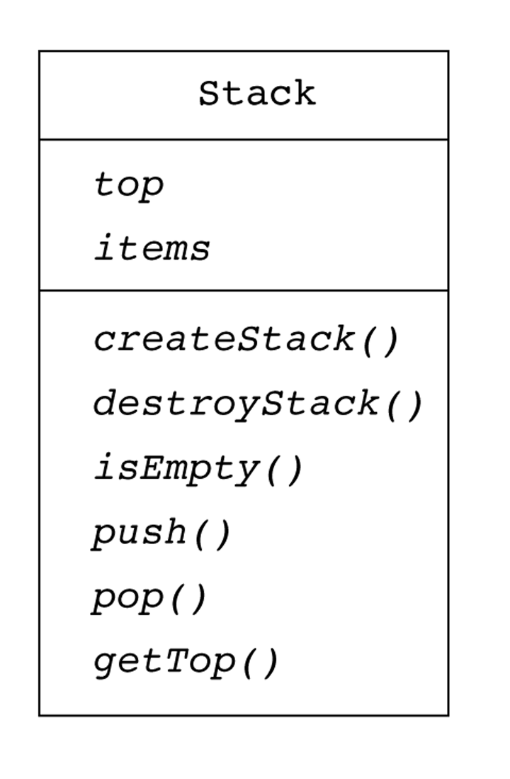
Stack ADT
char stack[Size]; //characters
while (not-end-of string){
read(ch)
if (ch is ‘{‘)
push(stack,ch);
else if (ch is ‘}’){
if( stackempty()){
destroystack();
return unbalanced;
}
item = pop(stack);
}
}end while
if (stackempty())
return balanced;
destroyStack();
return unbalanced;

Slide 8
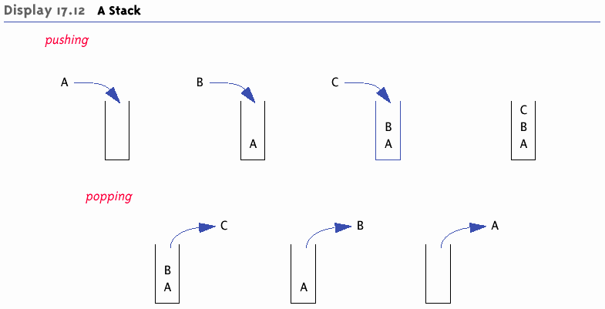
A Stack -- Graphic

Slide 9
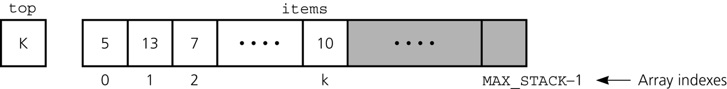
Array-Based Implementation
char/int stack[MAXSTACK]
bool stackfull();
bool stackempty();
void push(stack, item);
char pop(stack);
char gettopitem(stack);
itemtype stack[MAXSTACK];
int top; //”top” of stack
};

Slide 10
Push – item on Stack
push (stack, item) item is of type char
if (not stackfull()) stack must not be full
stack[top] = item add item
top = top + 1 increment top-of-stack
else
write(“Stack is full, can’t add item”)
end if
end push

Slide 11
Pop – item of Stack
char pop (stack) popped item is of type char
if (not stackempty() ) stack must not be empty
top = top – 1 decrement the top-of-stack
item = stack[top] item on top of stack
return item
else
write(“Stack is empty, can’t pop item”)
end if
end pop

Slide 12
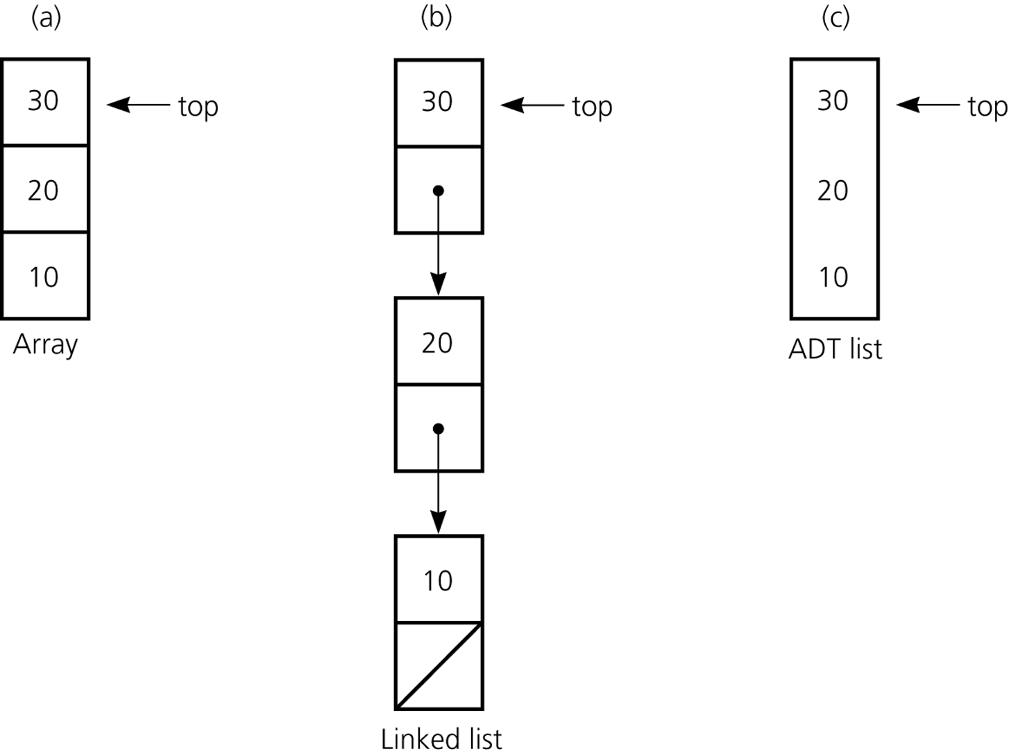
Compare Two Implementations
Will do this later.
Array vs. Linked List
  Fixed size v.s. dynamic size
  Simplicity vs Efficiency
  Array easier to program
Linked List vs. Array
  Memory efficiency v.s. Simplicity

Slide 13
Application: Algebraic Expressions
Infix expressions
  Every binary operator appears between its operands: a+b*c, (a+b)*c
Prefix expressions
  Operator appears before its operands: +a*bc, *+abc
Postfix expressions
  Operator appears after its operands: abc*+, ab+c*

Slide 14
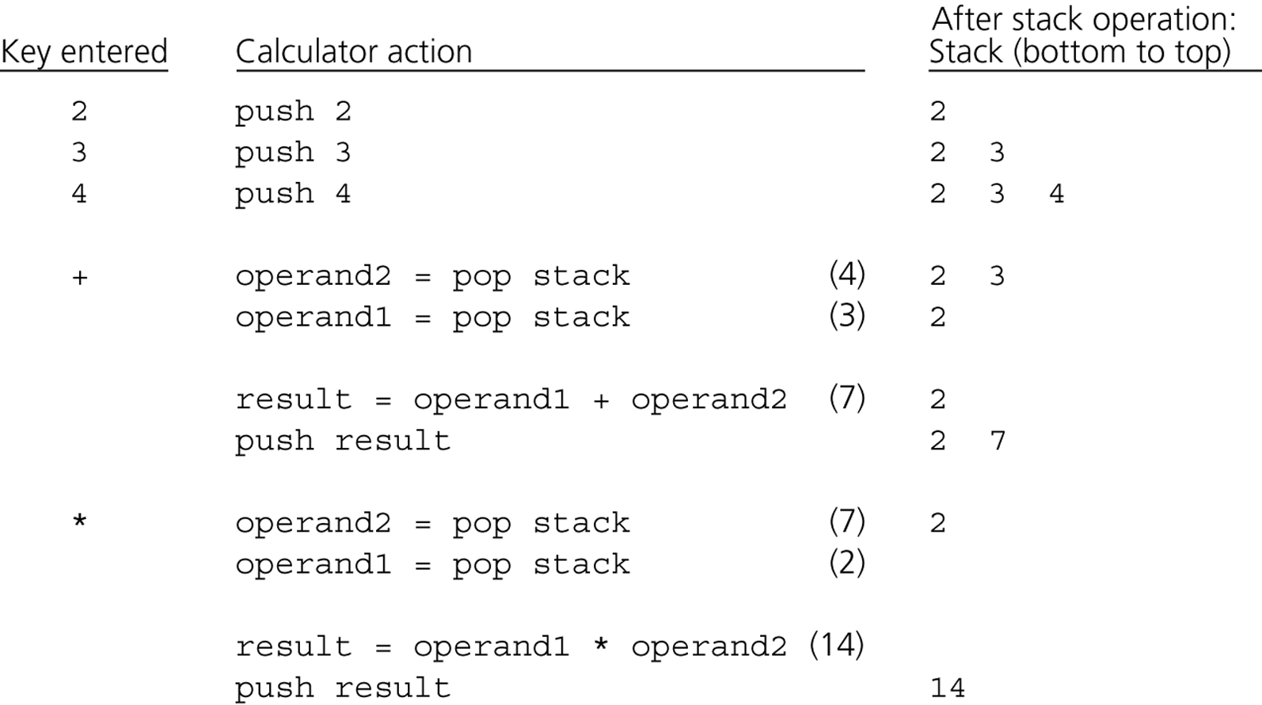
Evaluating Postfix Expressions

Slide 15
Pseudocode (binary operations only)
int mystack[MAXSTACK]; //declare a stack
for (each character t in the input){
if (t is an operand)
push(mystack,t);
else {
// pop top item of stack
operand2 = pop(mystack);
// pop top item of stack again
operand1 = pop(mystack);
// compute binary operation
result = operand1 t operand2;
push(mystack, result);
}
}

Slide 16
Postfix Evaluation Algorithm
Initialise stack to empty;
while (not end of postfix expression) {
Get next postfix item (char)
if (item is operand)
push(stack, item)
else if (item is binary operator) {
x = pop(stack)
y = pop(stack)
z = y operator x
push(stack, z) }
else if (item is unary operator) {
x = pop(stack)
z = operator(x)
push(stack,z) }
}
result = pop(stack) // single value at end on stack

